Slide 1
Chapter 3: Classes and Data Abstraction(II)
Outline
3.7 Initializing Class Objects: Constructors
3.8 Using Default Arguments with Constructors
3.9 Using Destructors
3.10 When Constructors and Destructors Are Called
3.11 Using Data Members and Member Functions
3.12 A Subtle Trap: Returning a Reference to a private Data Member
3.13 Assignment by Default Memberwise Copy
3.14 Software Reusability
Objectives
In this chapter, you will learn:
  To understand how to create, use, and destroy class objects.
  To be able to control access to object data members and member functions.
  To begin to appreciate the value of object orientation.

Slide 2
3.7 Initializing Class Objects: Constructors (I)
Constructor function
  Can initialize class members
  Same name as the class, no return type
  Member variables can be initialized by the constructor or set afterwards
Defining objects
  Initializers can be provided
  Initializers passed as arguments to the class’ constructor

Slide 3
3.7 Initializing Class Objects: Constructors (II)
Format
Type ObjectName( value1, value2, …);
  Constructor assigns value1, value2, etc. to its member variables
  If not enough values specified, rightmost parameters set to their default (specified by programmer)
  myClass myObject( 3, 4.0 );

Slide 4
3.8 Using Default Arguments with Constructors
Default constructor
  One per class
  Can be invoked without arguments
  Has default arguments
Default arguments
  Set in default constructor function prototype (in class definition)
    Do not set defaults in the function definition, outside of a class
  Example:
    SampleClass( int = 0, float = 0);
    Constructor has same name as class

Slide 5
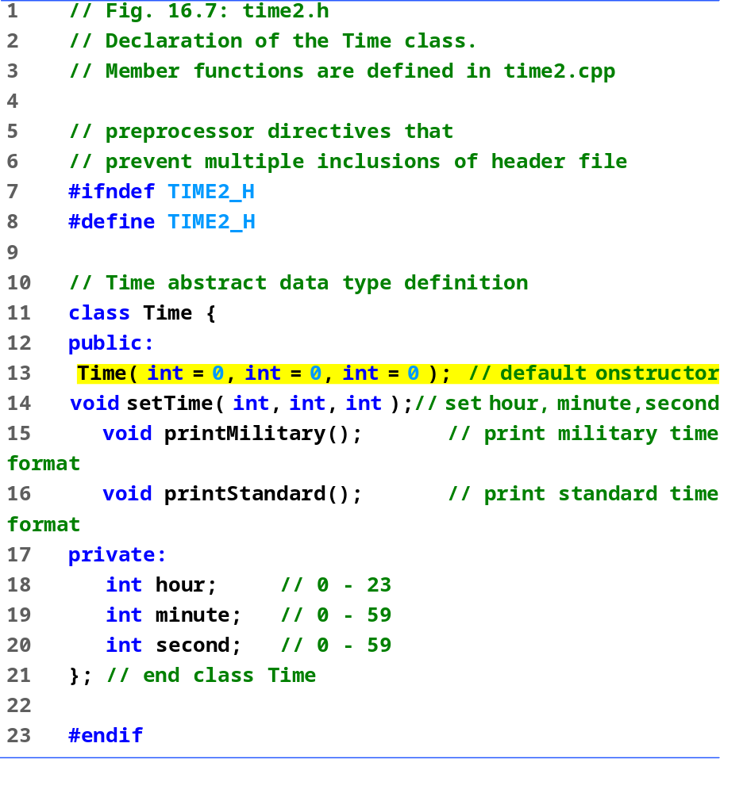
time2.h

Slide 6
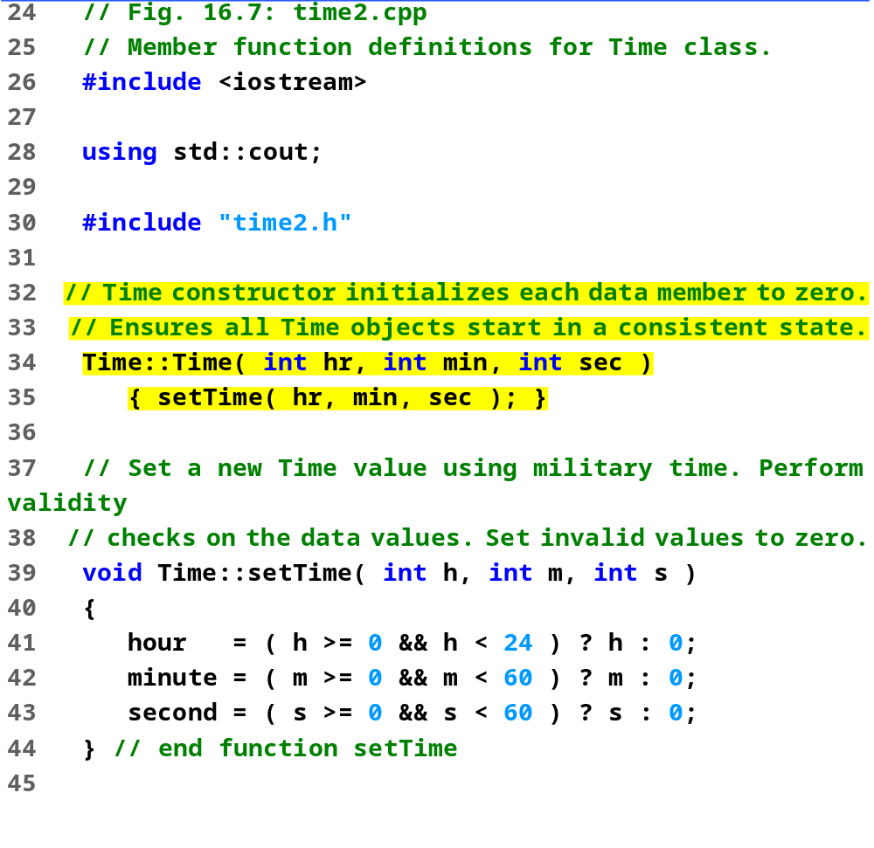
time2.cpp (Part 1 of 2)

Slide 7
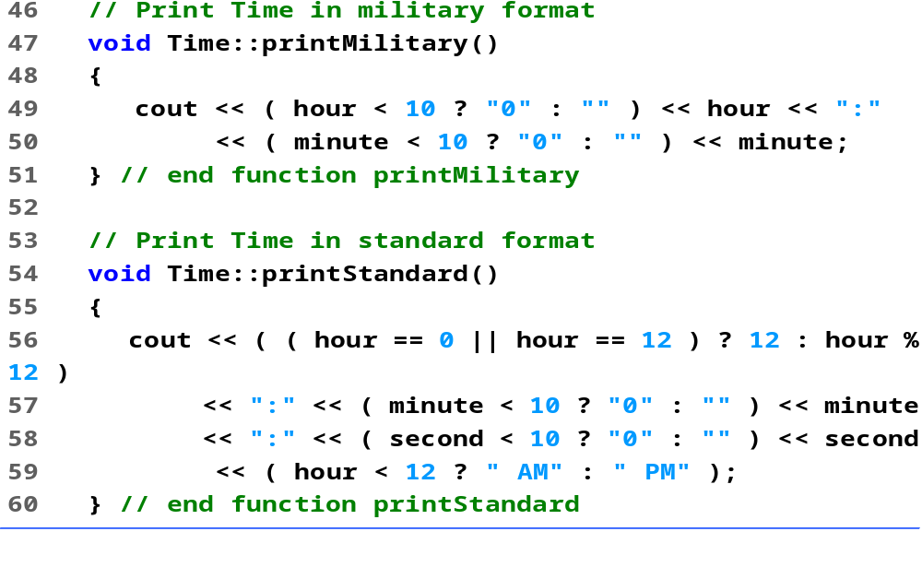
time2.cpp (Part 2 of 2)

Slide 8
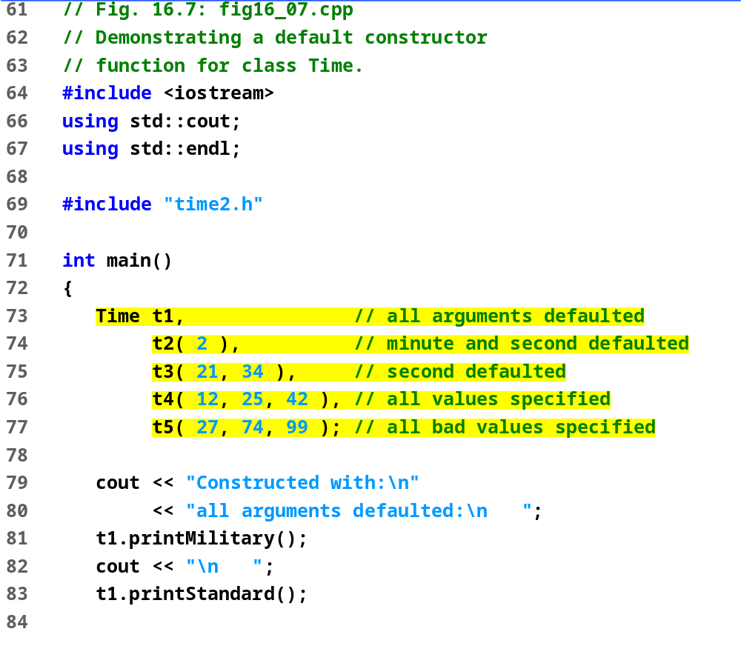
fig16_07.cpp (Part 1 of 2)

Slide 9
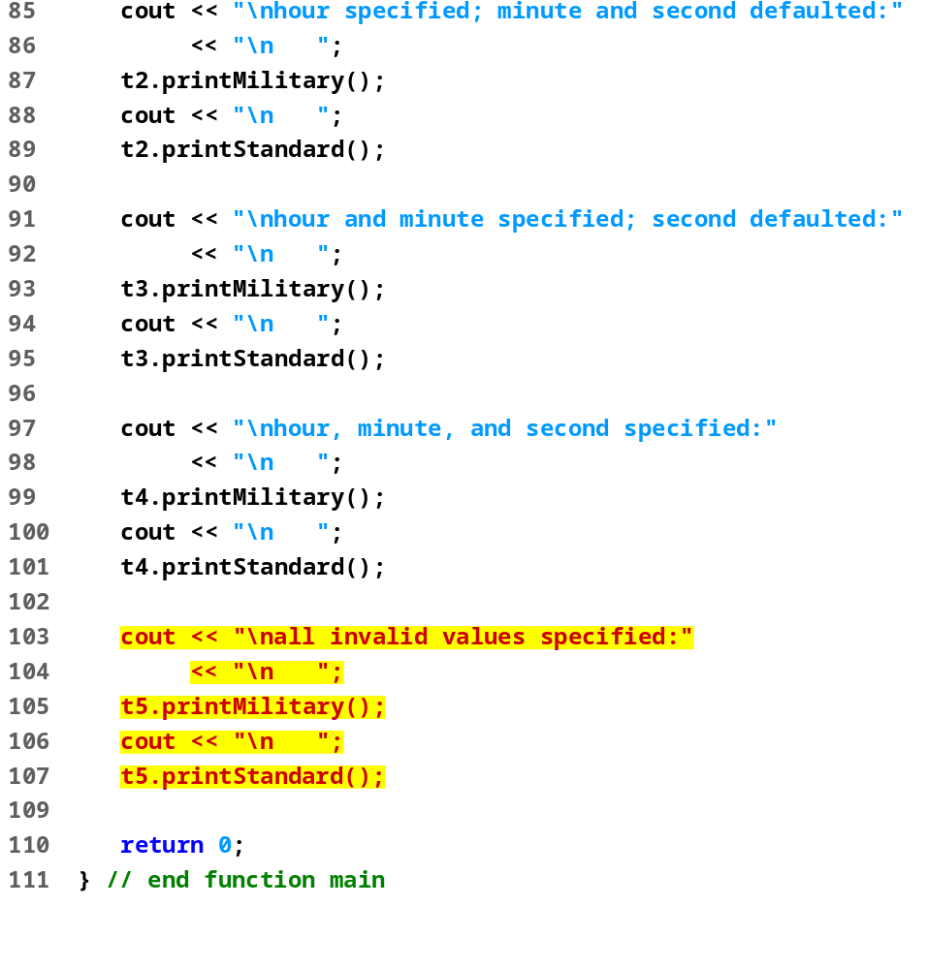
fig16_07.cpp (Part 2 of 2)

Slide 10
Program Output
Constructed with:
all arguments defaulted:
00:00
12:00:00 AM
hour specified; minute and second defaulted:
02:00
2:00:00 AM
hour and minute specified; second defaulted:
21:34
9:34:00 PM
hour, minute, and second specified:
12:25
12:25:42 PM
all invalid values specified:
00:00
12:00:00 AM

Slide 11
3.9 Using Destructors
Destructor
  Member function of class
  Performs termination housekeeping before the system reclaims the object’s memory
  Complement of the constructor
  Name is tilde (~) followed by the class name
    ~Time
    Recall that the constructor’s name is the class name
  Receives no parameters, returns no value （无形参定义）
  One destructor per class - no overloading allowed

Slide 12
3.9 Using Destructors
  析构函数在对象生命周期结束时，回收其所占用的内存空间。
  析构函数是“反向”的构造函数，析构函数不允许有返回值，不带参数，一个类中只有一个。
  析构函数的作用正好与构造函数相反。当对象超出其作用范围，对应的内存空间被系统回收或被程序用delete删除时，析构函数将被调用。

Slide 13
3.10 When Constructors and Destructors Are Called(I)
Constructors and destructors called automatically
  Order depends on scope of objects
Global scope objects
  Constructors called before any other function (including main)
  Destructors called when main terminates (or exit function called)
  Destructors not called if program terminates with abort

Slide 14
3.10 When Constructors and Destructors Are Called(II)
Automatic local objects
  Constructors called when objects defined
  Destructors called when objects leave scope (when the block in which they are defined is exited)
  Destructors not called if program ends with exit or abort
static local objects
  Constructors called when execution reaches the point where the objects are defined
  Destructors called when main terminates or the exit function is called
  Destructors not called if the program ends with abort

Slide 15
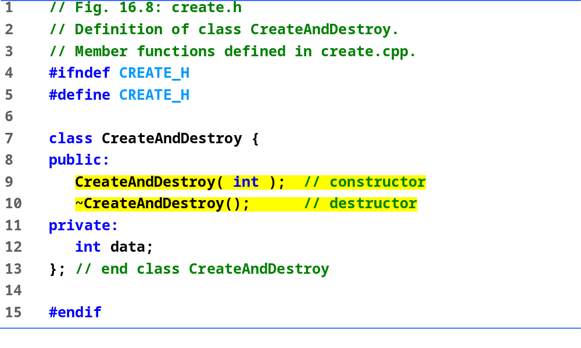
create.h

Slide 16
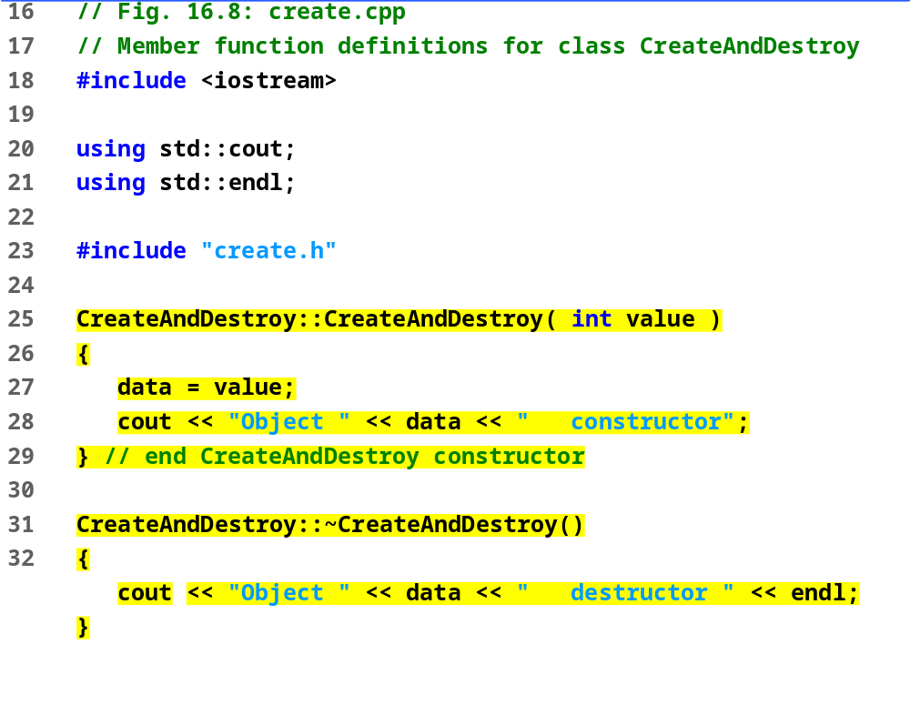
create.cpp

Slide 17
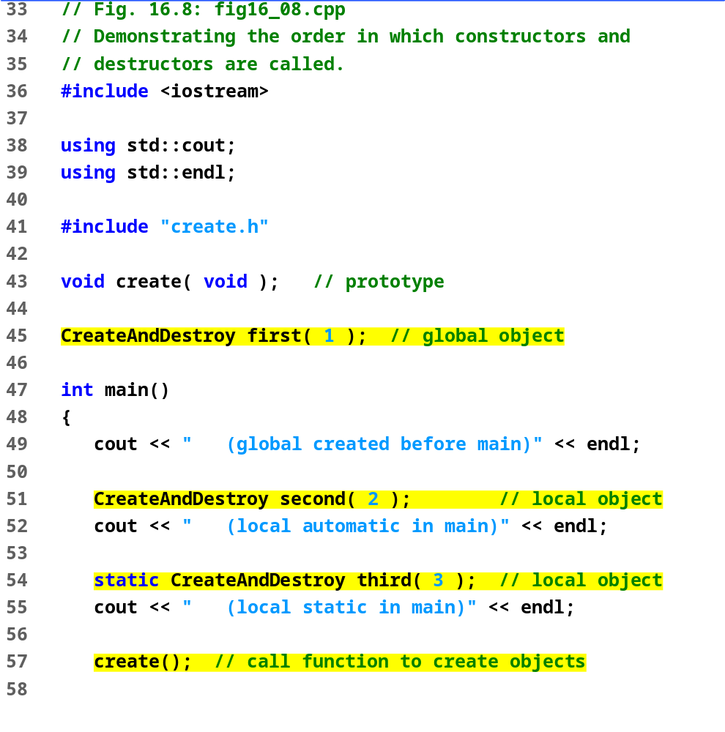
fig16_08.cpp (Part 1 of 2)

Slide 18
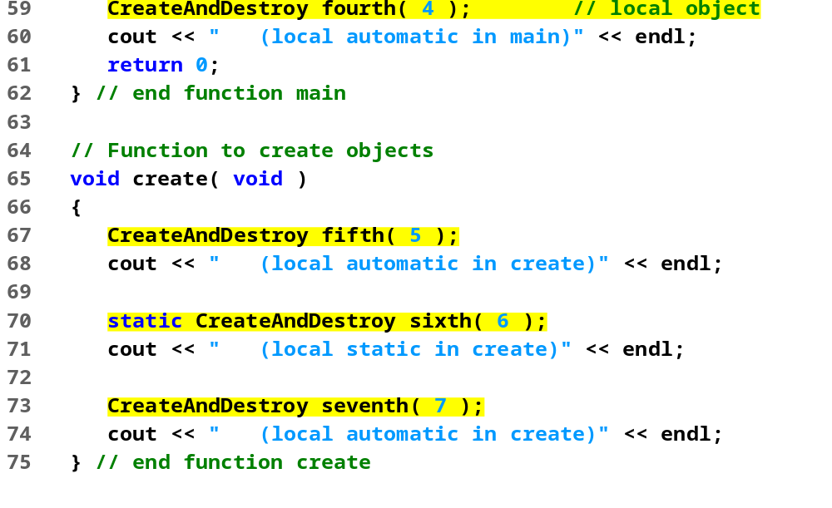
fig16_08.cpp (Part 2 of 2)

Slide 19
Program Output
Object 1 constructor (global created before main)
Object 2 constructor (local automatic in main)
Object 3 constructor (local static in main)
Object 5 constructor (local automatic in create)
Object 6 constructor (local static in create)
Object 7 constructor (local automatic in create)
Object 7 destructor
Object 5 destructor
Object 4 constructor (local automatic in main)
Object 4 destructor
Object 2 destructor
Object 6 destructor
Object 3 destructor
Object 1 destructor

Slide 20
3.11 Using Data Members and Member Functions
Classes provide public member functions
  Set (i.e., write) or get (i.e., read) values of private data members
  Adjustment of bank balance (a private data member of class BankAccount) by member function computeInterest
Naming
  Member function that sets interestRate typically named setInterestRate
  Member function that gets interestRate would typically be called getInterestRate

Slide 21
3.11 Using Data Members and Member Functions (II)
Do set and get capabilities effectively make data members public?
  No!
  Programmer decides what the function can set and what information the function can get
public set functions should
  Check attempts to modify data members
  Ensure that the new value is appropriate for that data item
  Example: an attempt to set the day of the month to 37 would be rejected
  Programmer must include these features

Slide 22
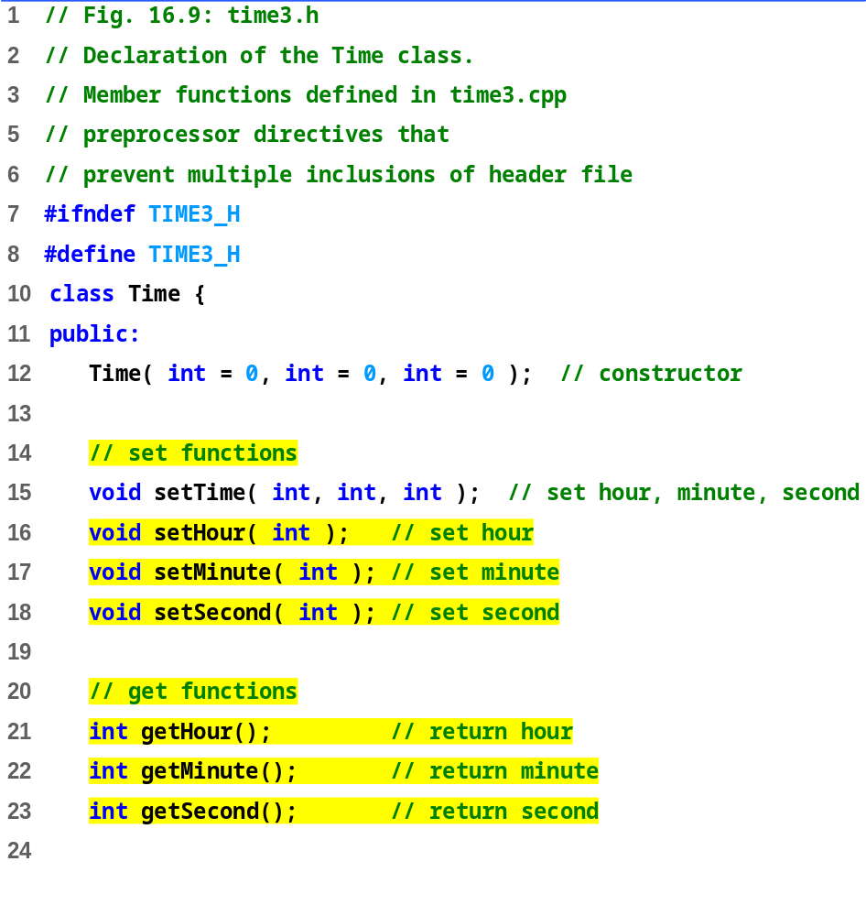
time3.h (Part 1 of 2)

Slide 23
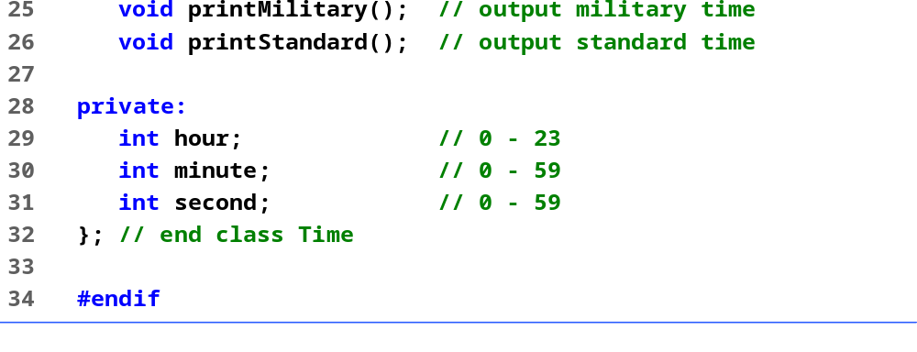
time3.h (Part 2 of 2)

Slide 24
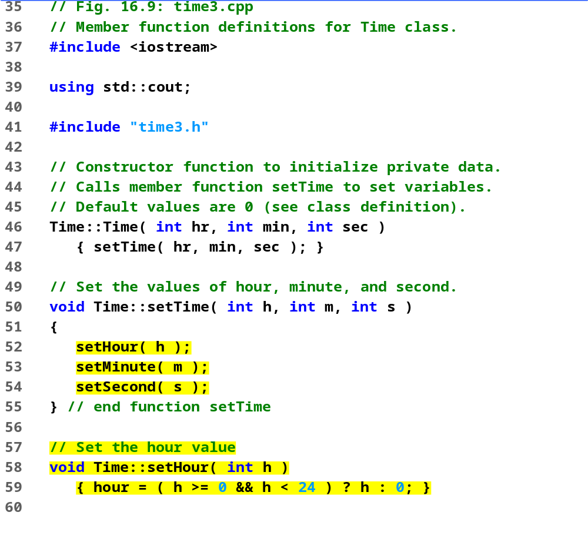
time3.cpp (Part 1 of 3)

Slide 25
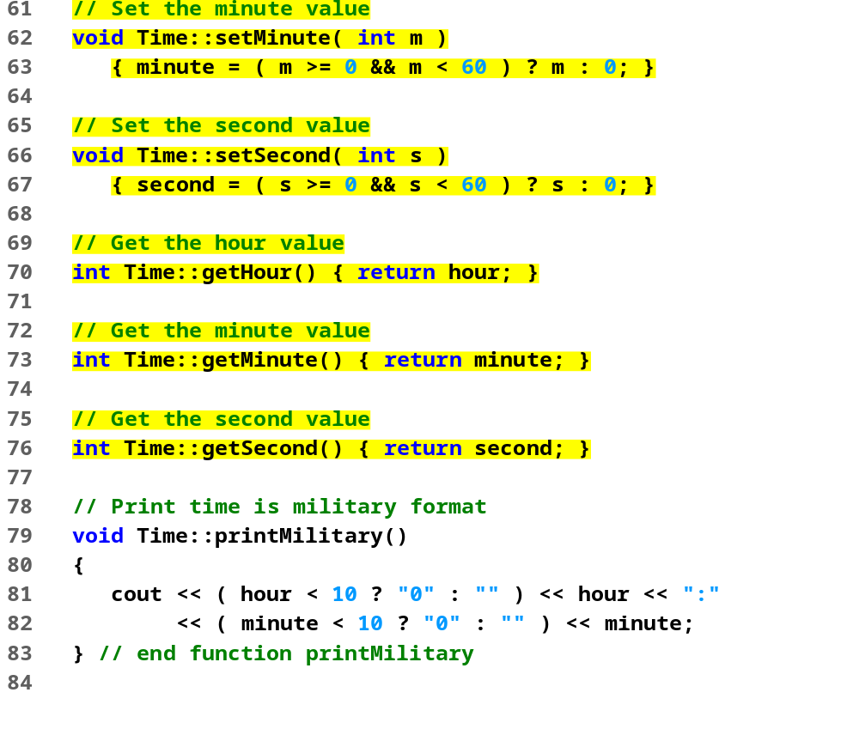
time3.cpp (Part 2 of 3)

Slide 26
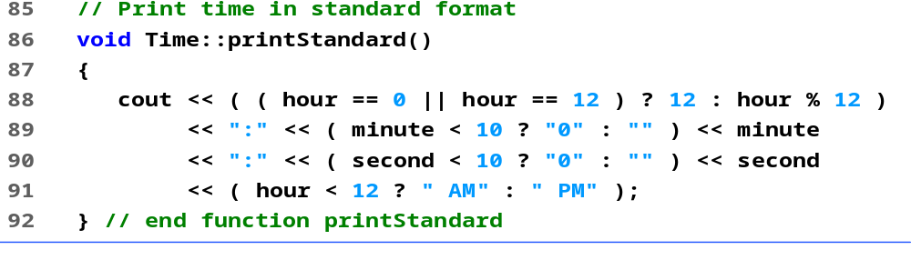
time3.cpp (Part 3 of 3)

Slide 27
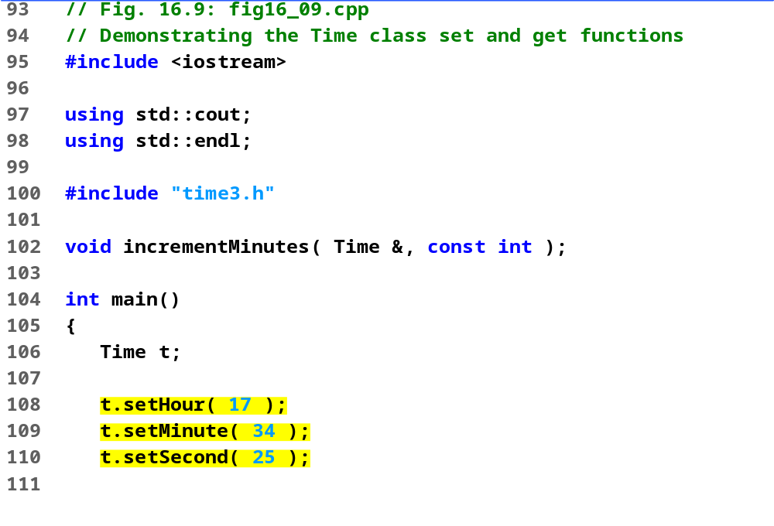
fig16_09.cpp (Part 1 of 3)

Slide 28
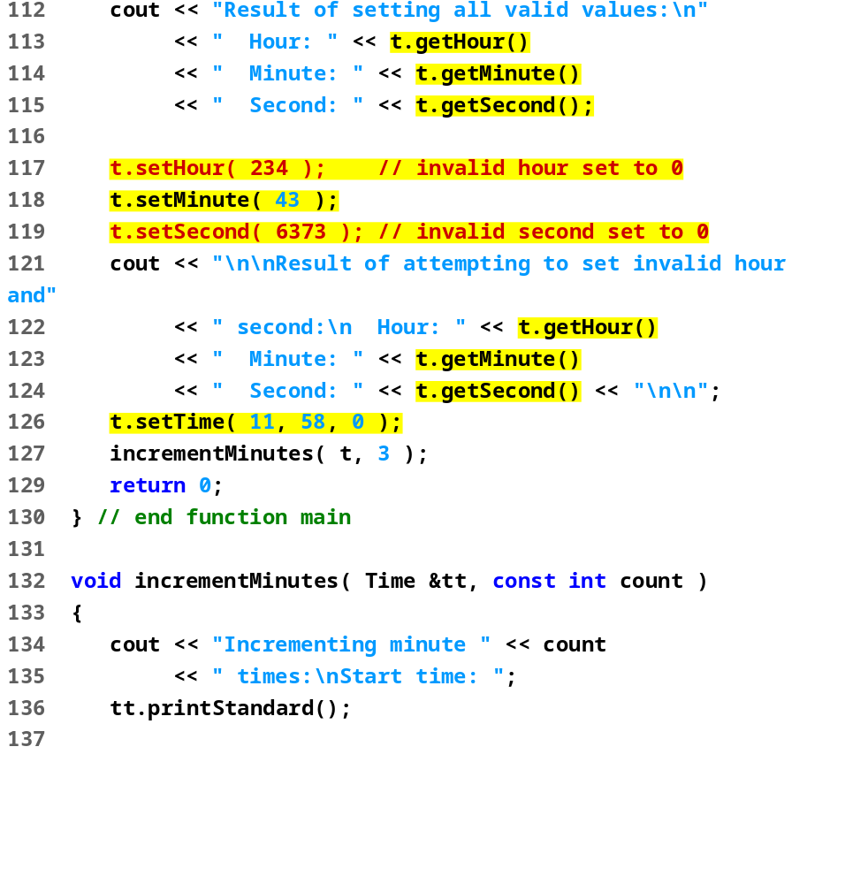
fig16_09.cpp (Part 2 of 3)

Slide 29
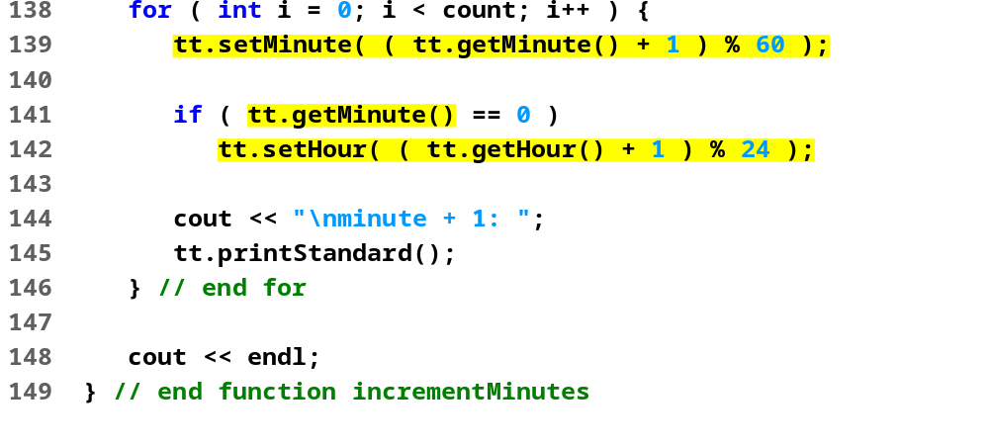
fig16_09.cpp (Part 3 of 3)
Result of setting all valid values:
Hour: 17 Minute: 34 Second: 25
Result of attempting to set invalid hour and second:
Hour: 0 Minute: 43 Second: 0
Incrementing minute 3 times:
Start time: 11:58:00 AM
minute + 1: 11:59:00 AM
minute + 1: 12:00:00 PM
minute + 1: 12:01:00 PM
Program Output

Slide 30
3.12 A Subtle Trap: Returning a Reference to a Private Data Member
Reference to an object
  Alias for the name of the object
  May be used on the left side of an assignment statement
  Reference can receive a value, which changes the original object as well
One way to use this capability (unfortunately!)
  Have a public member function of a class return a non-const reference to a private data member
  This reference can be modified, which changes the original data

Slide 31
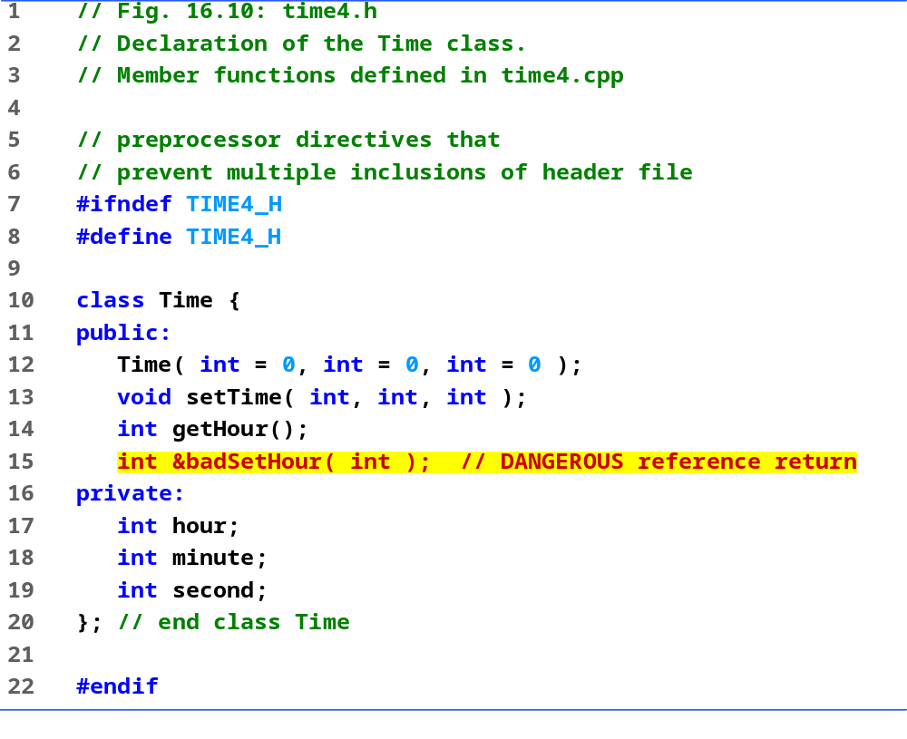
time4.h

Slide 32
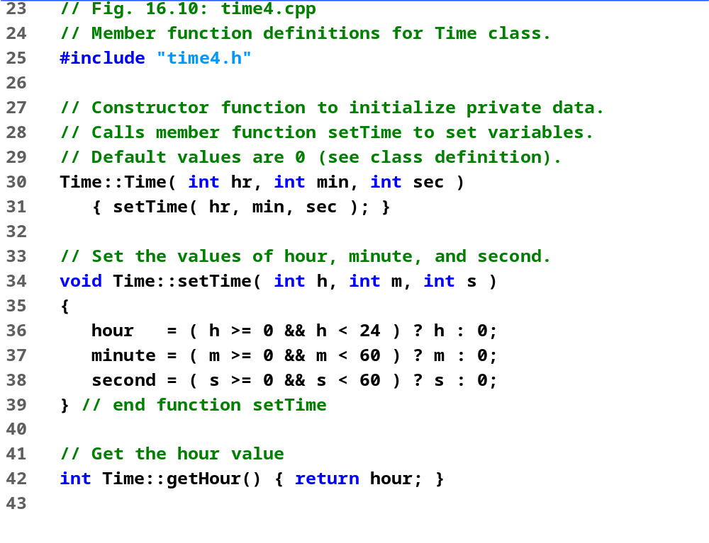
time4.cpp (Part 1 of 2)

Slide 33
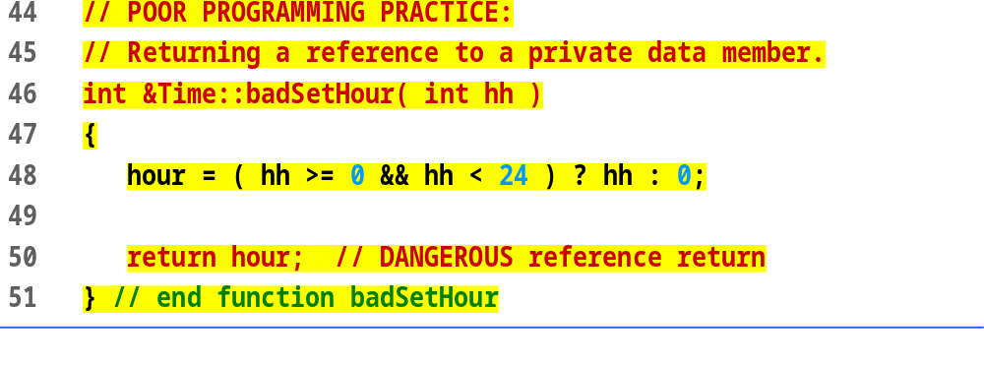
time4.cpp (Part 2 of 2)

Slide 34
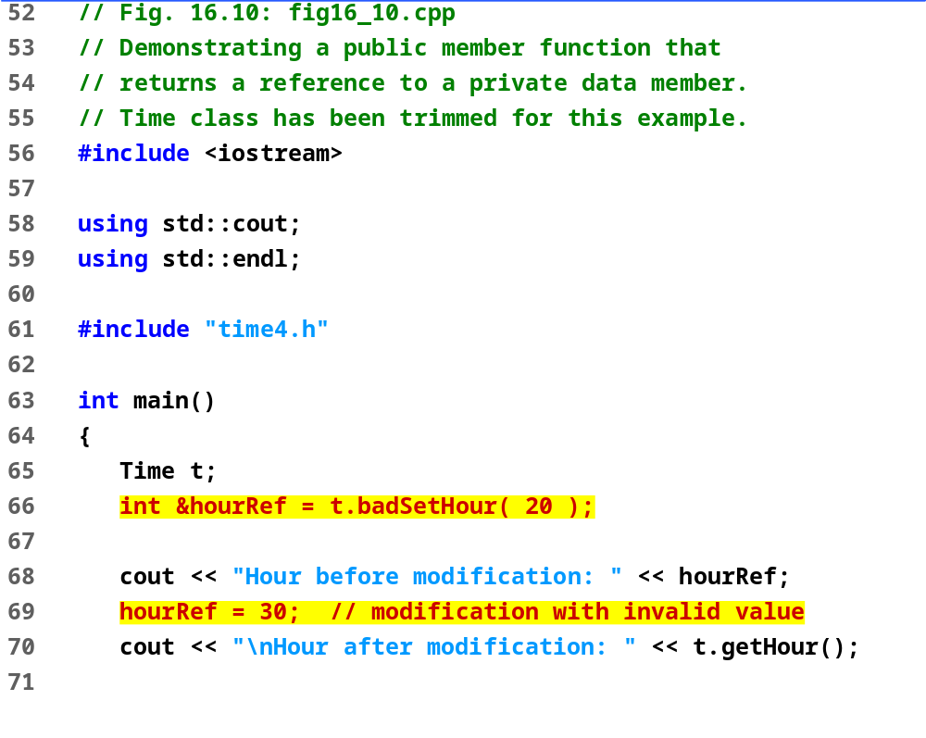
fig16_10.cpp (Part 1 of 2)

Slide 35
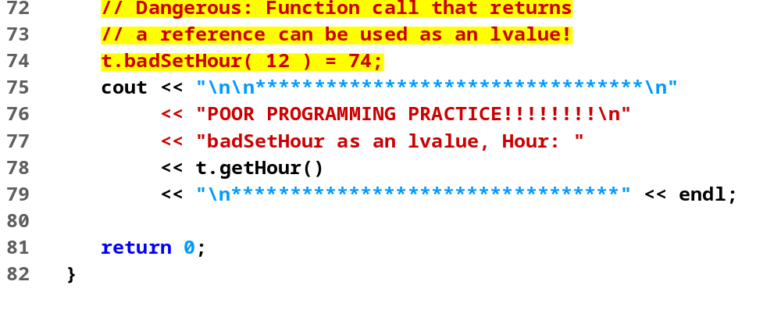
fig16_10.cpp (Part 2 of 2)
Program Output
Hour before modification: 20
Hour after modification: 30
*********************************
POOR PROGRAMMING PRACTICE!!!!!!!!
badSetHour as an lvalue, Hour: 74
*********************************

Slide 36
3.13 Assignment by Default Memberwise Copy
Assignment operator (=)
  Sets variables equal, i.e., x = y;
  Can be used to assign an object to another object of the same type
  Memberwise copy — member by member copy
  myObject1 = myObject2;
Objects may be
  Passed as function arguments
  Returned from functions (call-by-value default)
    Use pointers for call by reference

Slide 37
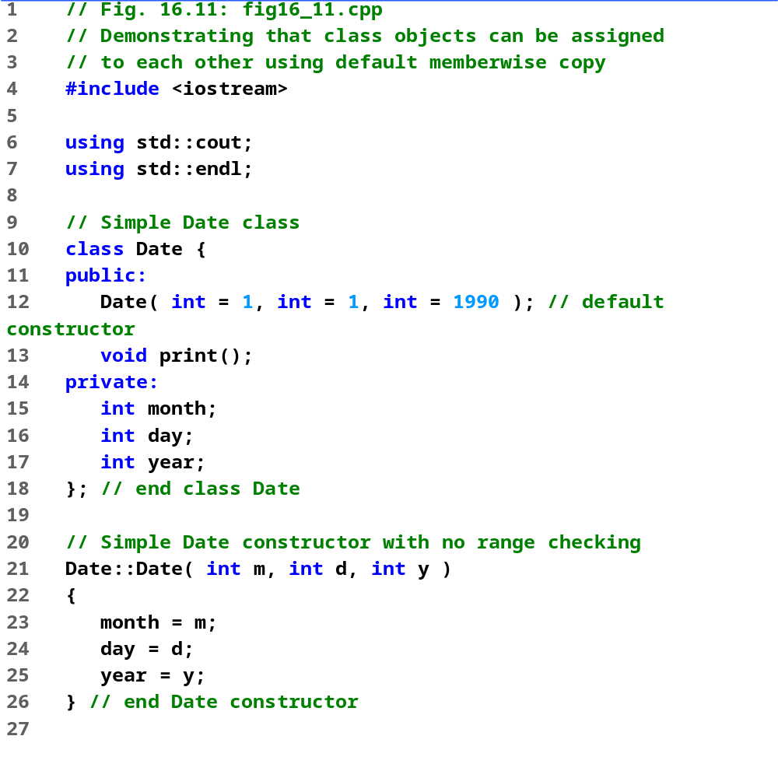
fig16_11.cpp (Part 1 of 2)

Slide 38
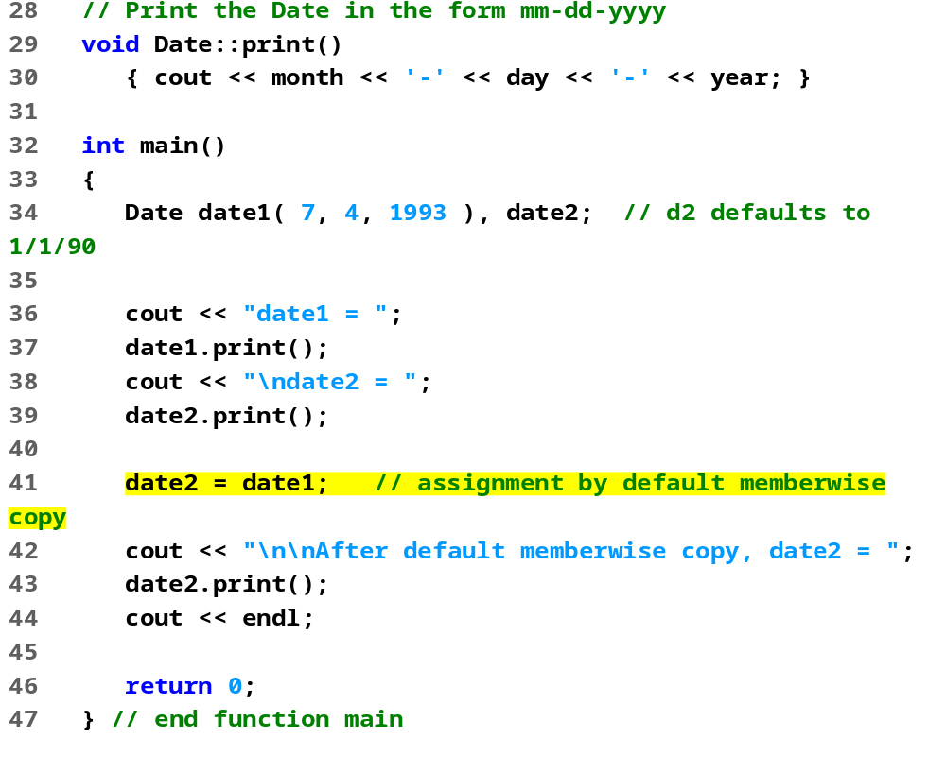
fig16_11.cpp (Part 2 of 2)
date1 = 7-4-1993
date2 = 1-1-1990
After default memberwise copy, date2 = 7-4-1993
Program Output

Slide 39
3.14 Software Reusability
Object-oriented programmers
  Concentrate on implementing useful classes
Tremendous opportunity to capture and catalog classes
  Accessed by large segments of the programming community
  Class libraries exist for this purpose
Software
  Constructed from existing, well-defined, carefully tested, portable, widely available components
  Speeds development of powerful, high-quality software

Slide 40
Thank you !

